Slide 1
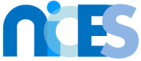

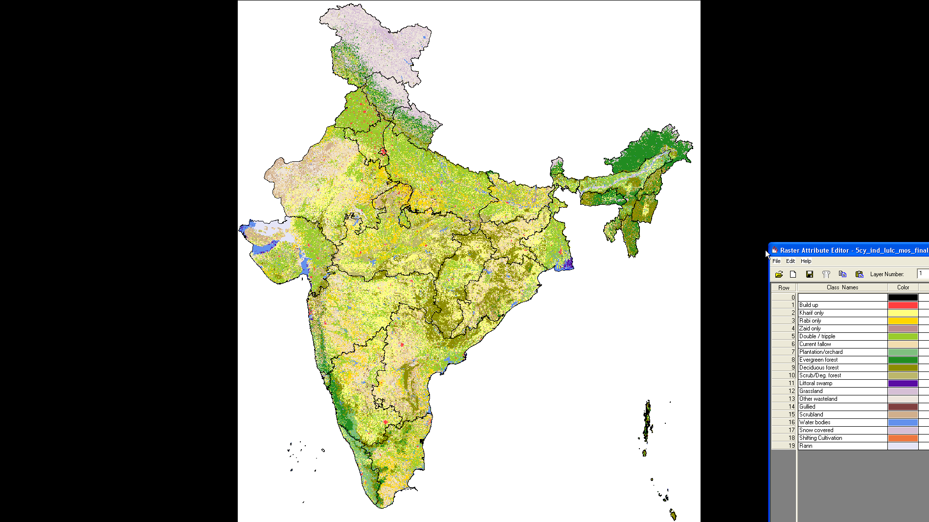
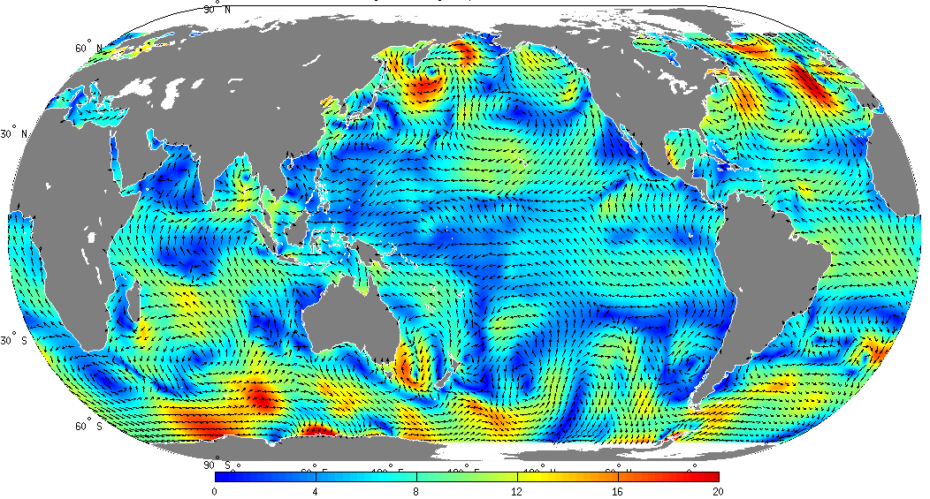
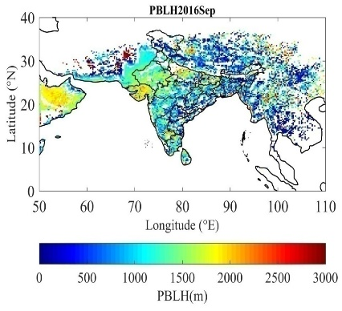
National Information system for Climate and Environment Studies (NICES)
GODEX-NWP meeting, Prithvi Bhavan, New Delhi, 27-30 November, 2018
Dr D. Dutta
Climate Studies Group
NRSC (ISRO)
http://nrsc.gov.in/nices2/index.html

Slide 2
Background and Objectives of NICES
Established in November, 2012 at NRSC (ISRO).
Co-funded (DOS, MoEF, MoES, DST) and Multi-Institutional endeavour.
Creation of observational network, calibration and validation sites.
Realization of national level long term, consistent climate database generation for climate change studies.
Generation ECVs for impact assessment, adaptation, vulnerability and mitigation study.
Establishment of necessary infrastructure, NICES portal and web-enabled services for dissemination of products.
Satellite observation
Ground sensor network
Antarctica study
Generation of Bio-geophysical products
Participation in Cruises
Realization of national climate database
GODEX-NWP meeting, Prithvi Bhavan, New Delhi, 27-30 November, 2018
Outreach and Capacity building
Product validation
Web-enabled services
Modelling
Infrastructure development
NICES activities

Slide 3
Ongoing activities
Realization of long-term climate quality geo/bio-physical products
Terrestrial, Cryosphere, Atmospheric and Ocean
Climate variability / change studies
Studies on radiative forcing and land surface processes
Aerosols, Clouds and GHGs
Changes in LULC and regional meteorology
PBL dynamics – boundary layer processes, air pollution
Establishing in situ observational network
RANN (Radiosonde network for NICES), LDS (Lightning Detection System with chemiluminescent NO_{x} analyser & absorption spectrometer), GHG & Trace gases
Harnessing the information on climate studies for societal benefits
Radiation and wind forecasting
Modelling of air pollution (CO, FLEXPART; input NCEP/NCAR reanalysis data)
CAPE (Convective available potential energy) using INSAT-3D and SNPP (CrIS)
Polar research
Black carbon, GHGs, CO₂, CO, Albedo, Precipitation, AOD
Primary productivity, pCO₂, chlorophyll, IOP
Permafrost study
GODEX-NWP meeting, Prithvi Bhavan, New Delhi, 27-30 November, 2018
Notes:
SSA: Ground:Aethalometer provides absorption coefficient; Nephelometer: Scattering coefficient, AOD: sun photometer (g); OMI, MISR, MODIS-size distribution of aerosols from spectral aod
Satellite: CALIPSO for vertical distribution of aerosols; for dust aerosols color ratio (532, 1064 nm) and de-polarization ratio (532 nm); OMI also provides info on aod of Absorbing aerosols (UV)
Clouds: Clouds: cooling effect; semi transparent cirrus clouds lead to warming effect; GHGs: always increase temperature – concentration and vertical distribution (sounders: AIRS, IASI); A-TRAIN facilitates near synchronous observations; xxxx on METOP at 0930 and Aqua / Calipso at 1330; Terra at 1030
More the CAPE, more is the probility of the air parcel to move up and condense (as it loses heat as condenses)
Strength of Convection; Convective Available Potential Energy)

Slide 4
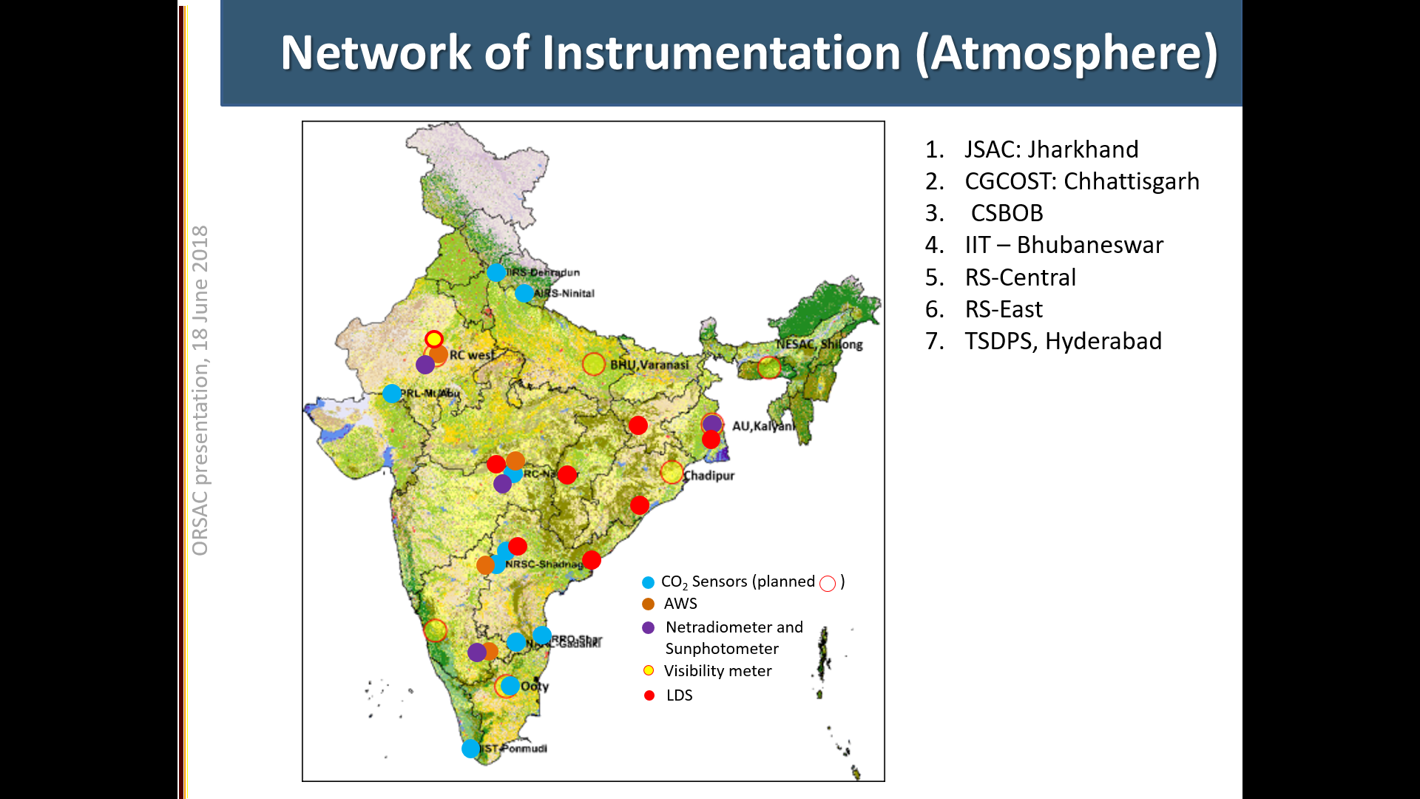
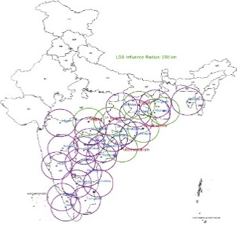
Studies on Ocean Biology
Ocean colour, Phytoplanktons, algal booms, productivity
Ocean / Coastal carbon dynamics
New bio-chemical products viz. TA, DIC, pCO₂
Integrated Bio-geo chemical modelling for productivity
Terrestrial productivity - NPP, NEP
Measurement and validation of ocean parameters
Network of 9 locations on East coast and 2 in the West
Spectro-radiometer, Coulometer, FRRF, IOP profiler, HPLC
Studies on new / planned EO sensors
NISAR, AVIRIS NG, Oceansat-3, GISAT, HYSIS
Internal waves, PFT-Size classes
Participation in opportunity cruises organized by NCAOR
Collaborative projects
Outreach and capacity building
Web enables services (http://nrsc.gov.in/nices2/index.html)
Maintenance, updating, download history etc.
Collaboration
GODEX-NWP meeting, Prithvi Bhavan, New Delhi, 27-30 November, 2018
LDS locations
Regional workshops

Slide 5
NICES products
Terrestrial (30)
Geophysical: Albedo, NDVI (4)
Hydrology: Surface water body, Soil moisture, ET, Runoff (4)
Landcover: MM-5, WRF compatible, Veg Fraction (3)
Terrain and Soil: OC, IOC, f-soil depth, f-soil texture, f-water erosion, f-wind erosion, f-salt affected, Soil moisture (8)
Vegetation and Ecosystem: Ann forest fire density, sd of AFFD, length of fire, f-forest, forest types, f-NSA, f-KSA, f-RSA, f-FA, NEP, NPP (11)
Ocean (26)
OHC₇₀₀ (1)
TCHP (1)
OHC & OMT (2)
Ocean surface winds (2)
Wind stress (2)
Wind curl: Wind curl, Ekman currents, geostrophic current, SSHA, ocean surface current, EKE, MMSLA (7)
Co-tidal map (k101, M2s2) (2)
Model derived: 26 degree isotherm, TCHP (2)
Sea level pressure (1)
Ocean color: Chlorophyll concn (OC₂, OC₄), Kd₄₉₀ (6), Total Alkalinity, Dissolved Inorganic Carbon, pCO₂
Atmospheric (3)
Cloud fraction
boundary layer height
Derived tropospheric ozone
Cryospheric (5)
Snow melt and freeze (Indian Himalaya)
Snow melt and freeze (Antarctica)
Snow cover fraction
Himalayan glacial lakes and water bodies
Snow albedo
GODEX-NWP meeting, Prithvi Bhavan, New Delhi, 27-30 November, 2018
Total 66 bio/geo-physical products
13 are candidates for ECV
Newly added – TA and pCO₂
Way forward
Inter comparison of datasets.
Innovative use of existing data.
Rigorous re-analysis.

Slide 6
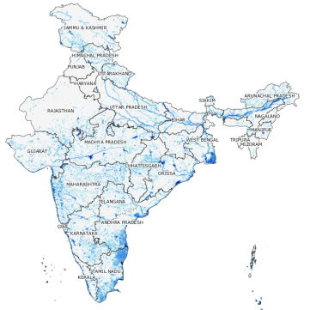
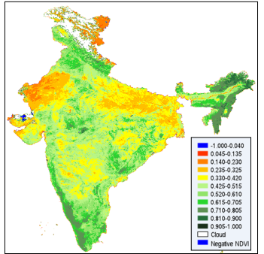
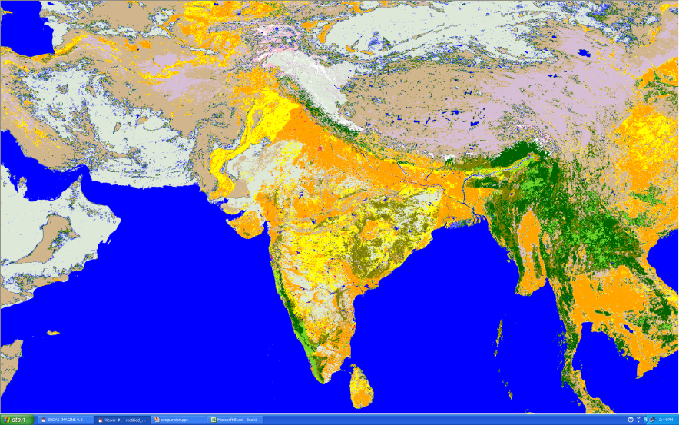

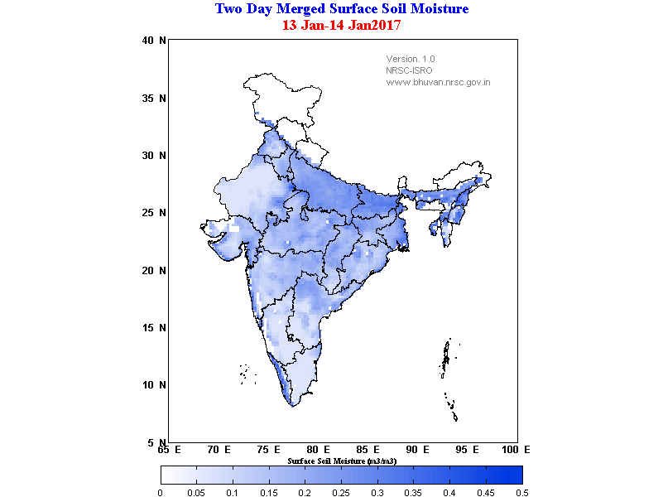
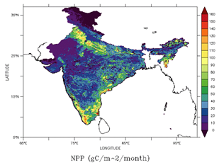
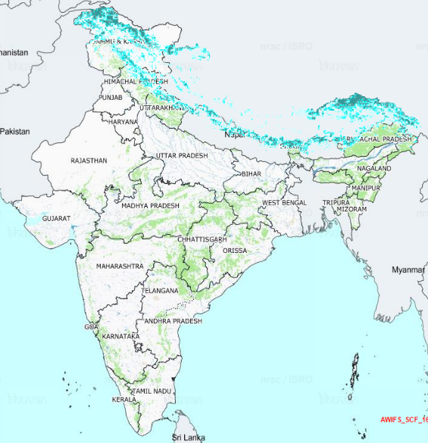

Terrestrial products
Water bodies fraction
(Fortnightly)
NDVI (Oceansat-2/OCM)
(1 km)
LULC (AwIFS, 250,000 scale)
GODEX-NWP meeting, Prithvi Bhavan, New Delhi, 27-30 November, 2018
Net Primary Productivity (gC m⁻² month⁻¹)
Snow Cover Fraction
Soil Moisture
Snow fraction (%)
2’ x 2’ resolution
(3’ x 3’)

Slide 7
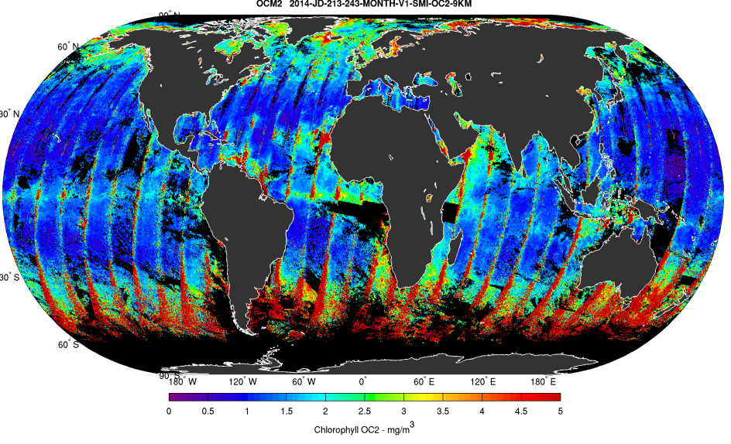
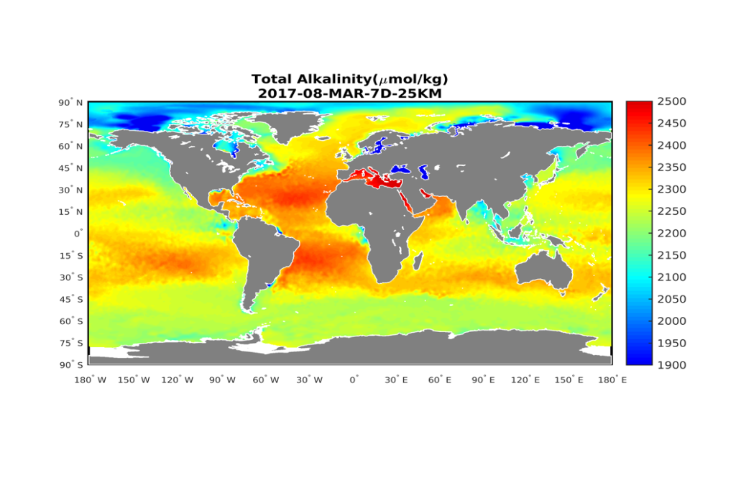
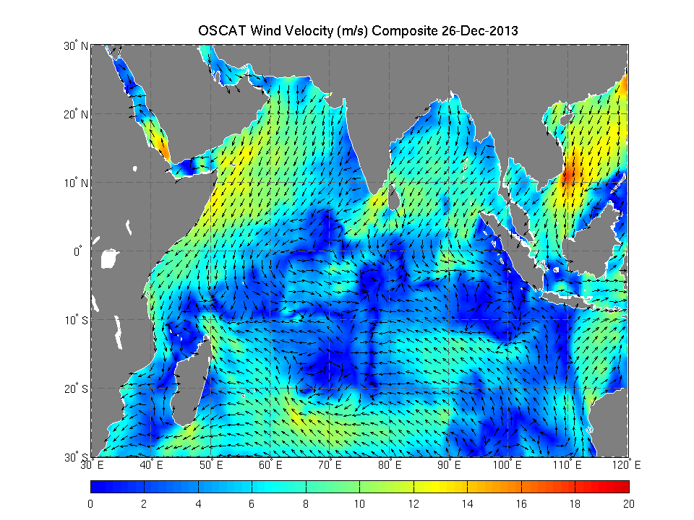
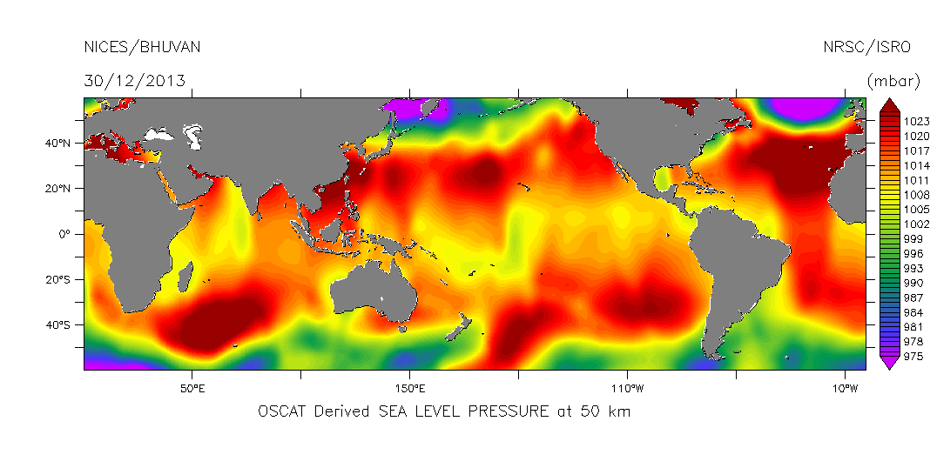
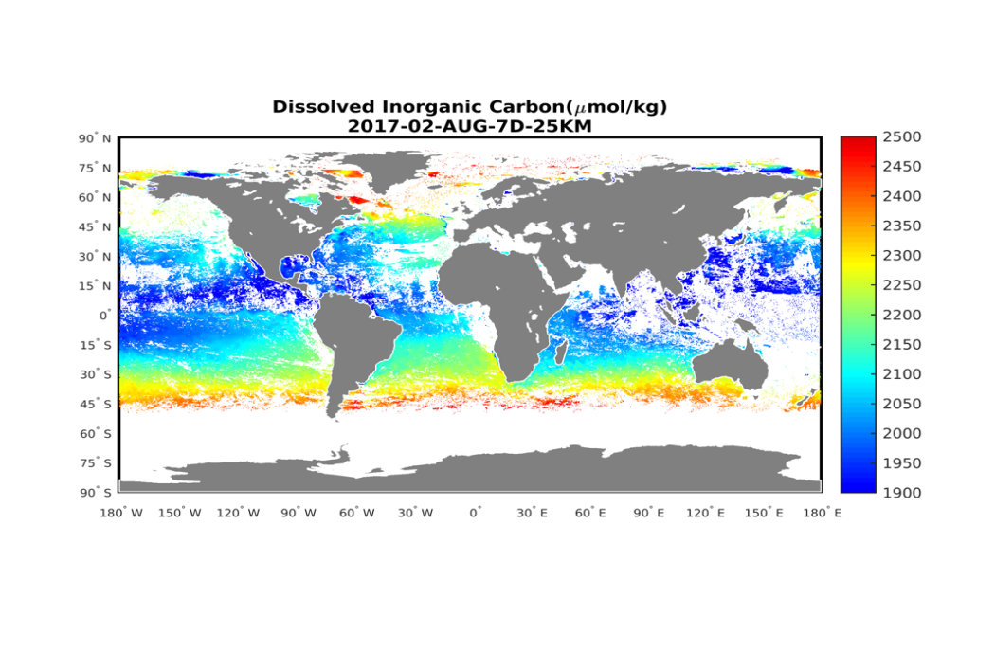
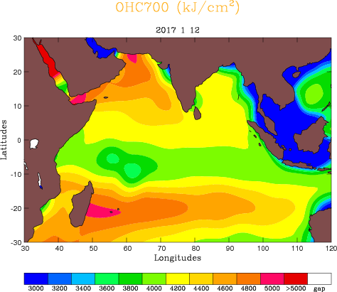
Ocean products
Ocean chlorophyll
Ocean Surface Winds
TA (µmole kg⁻¹)
(0.5º x 0.5º, 25 km)
Buffering capacity of the ocean (input: surface salinity + SST)
2 day, 8 day, monthly
GODEX-NWP meeting, Prithvi Bhavan, New Delhi, 27-30 November, 2018
OSCAT sea Level Pressure (50 km)
DIC (µmole kg⁻¹)
OHC 700m (kg cm⁻²)
(daily, 50 km x 50 km)
Important sink of atmospheric CO₂ as carbonate and bi-carbonate (biogeochemical process)
(0.25º x 0.25º)

Slide 8
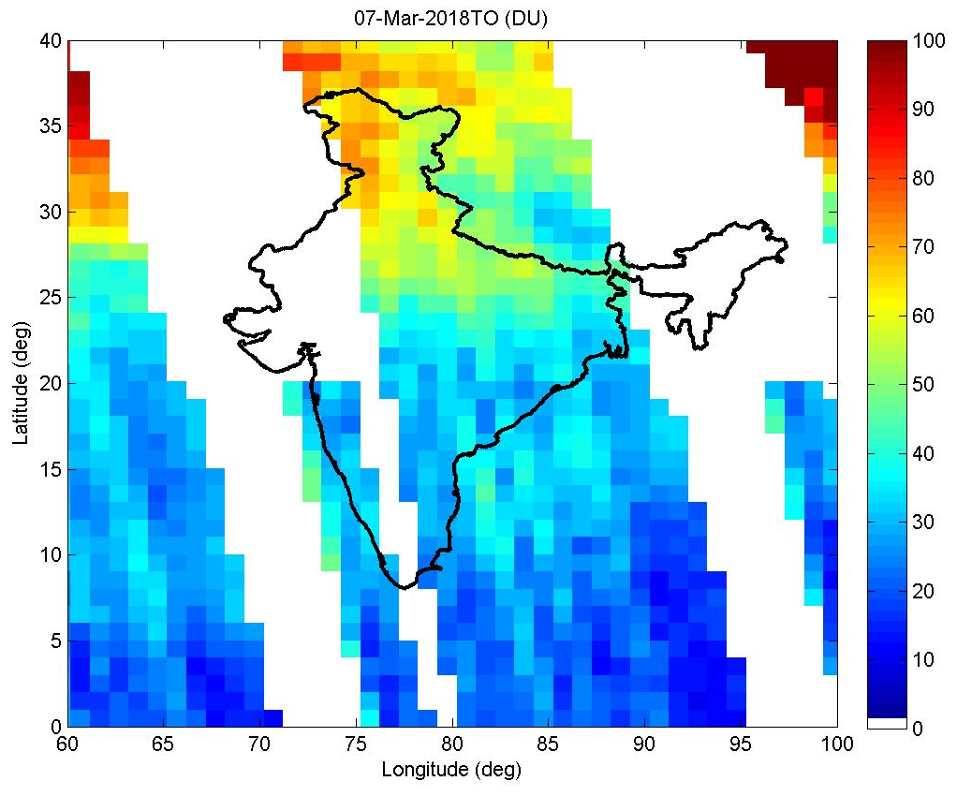
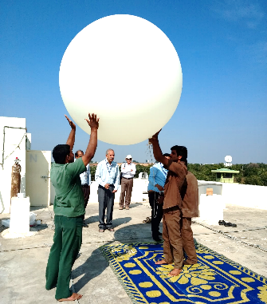
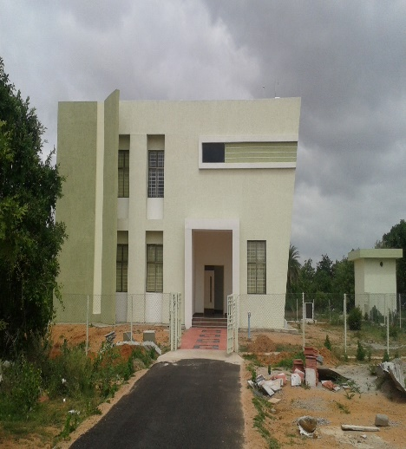
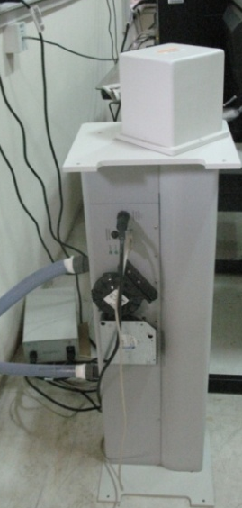
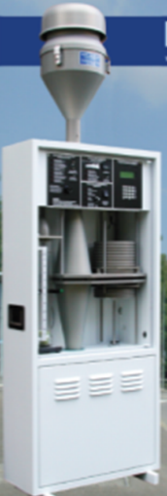
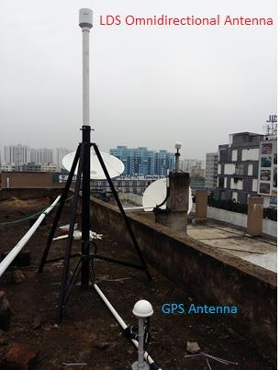
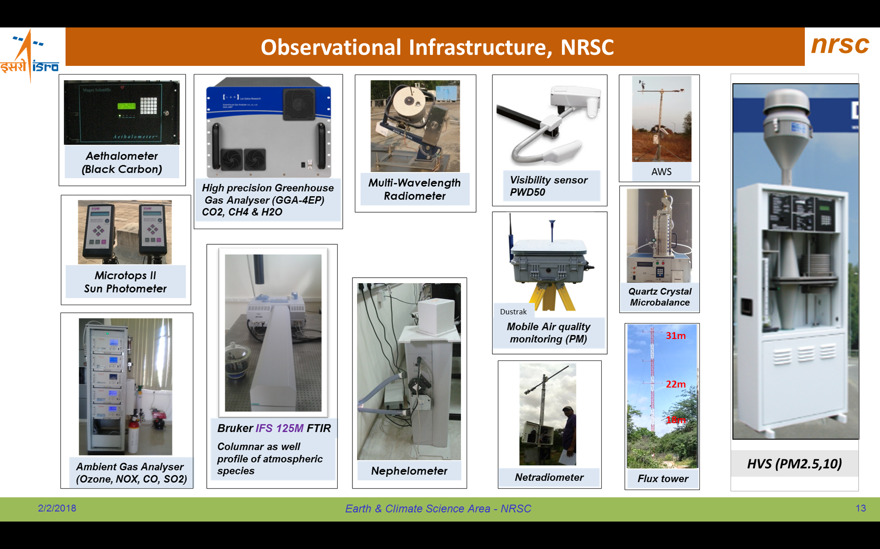
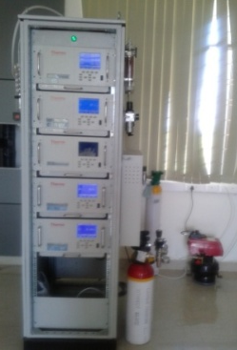
Atmospheric and Cryospheric products
PBLH (m)
(Using Suomi NPP/ CrIS, 0.25 deg )
Topospheric ozone
(Aura OMI, MLS, TOR-tech)
Radiosonde
(Temp, Pr, Humidity, WS, WD)
GODEX-NWP meeting, Prithvi Bhavan, New Delhi, 27-30 November, 2018
(0.25º x 0.25º)
(daily product, 1ºx 1º, 18 km TH)
(Radio transmitter, > 25 km ascent, GPS enabled)
Atmospheric Science Lab
FTIR
High Volume Sampler
LDS
Trace Gas Analyzer
  Flux tower

Slide 9
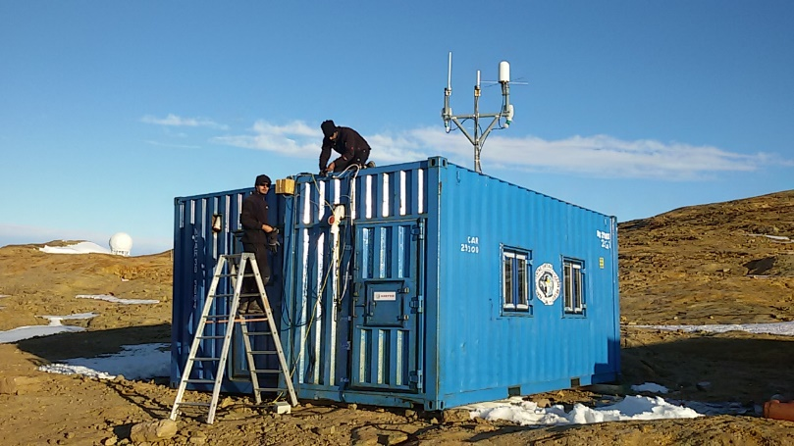
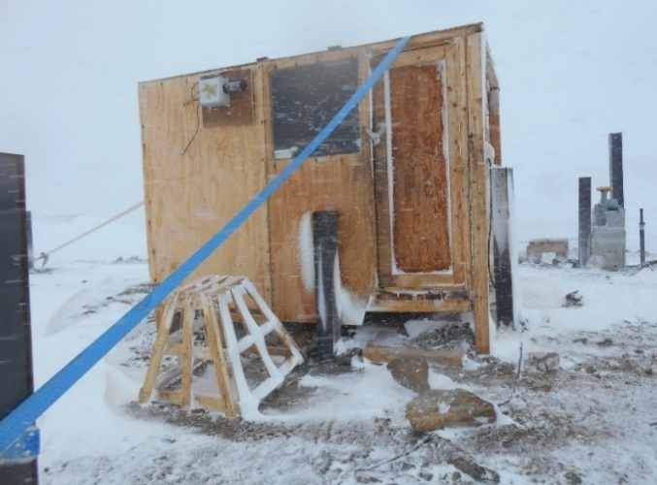
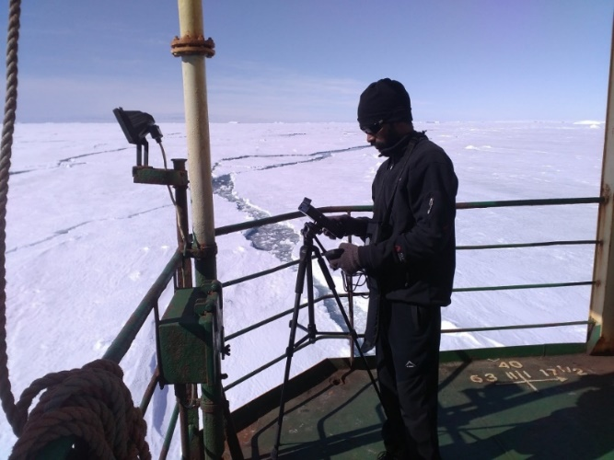
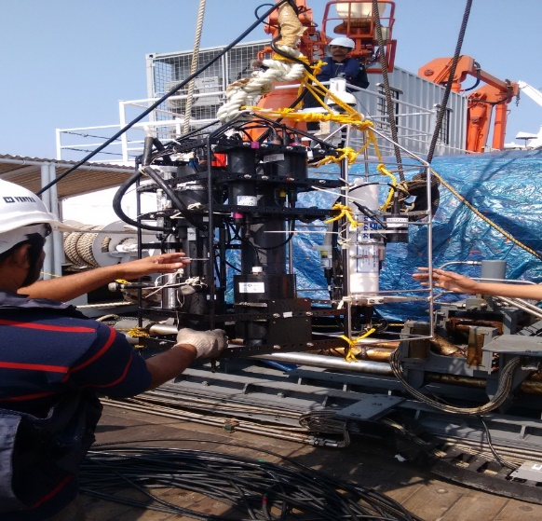
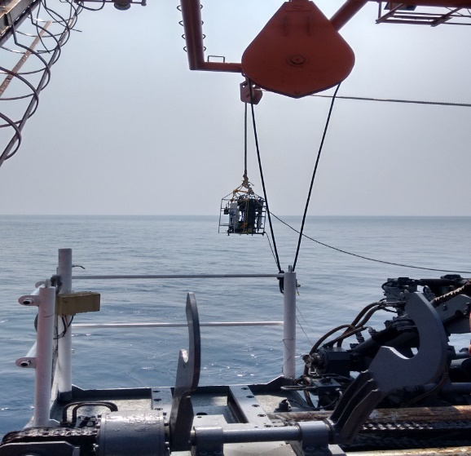
In-situ Data collections in Antarctica
GHG, BC, AOD and Snow Albedo
LI-840A CO₂/H₂O
Sunphotometer
In-situ Data collections in open ocean
Bay of Bengal, 11-16 Feb., 2016, instruments used are IOP and CTD, parameters measured include absorption, attenuation, back scattering, Chlorophyll, CDOM, conductivity, temperature, depth, DO, PAR and turbidity.
GODEX-NWP meeting, Prithvi Bhavan, New Delhi, 27-30 November, 2018

Slide 10
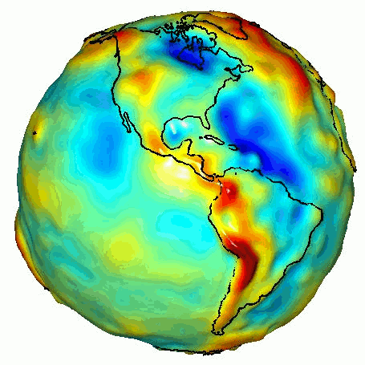

Thanks
GODEX-NWP meeting, Prithvi Bhavan, New Delhi, 27-30 November, 2018
The products are made available through NICES portal and the details of NICES programme, list of products and documents are available in NRSC website which can be accessed using: http://nrsc.gov.in/nices2/index.html
For further details, please contact:
Programme Director
National Information system for Climate and Environment Studies (NICES)
 +91-40-2388 4258/2377 1515
 ddecsa@nrsc.gov.in

